Slide 1
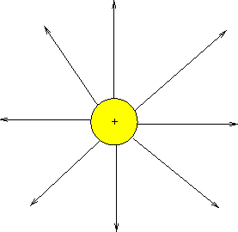

Analogy
The electric field is the space around an electrical charge
just like
a gravitational field is the space around a mass.

Slide 2
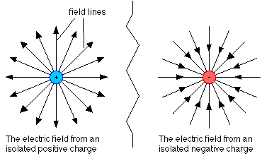
Electric Field
Space around a charge.

Slide 3
What is the difference?

Slide 4
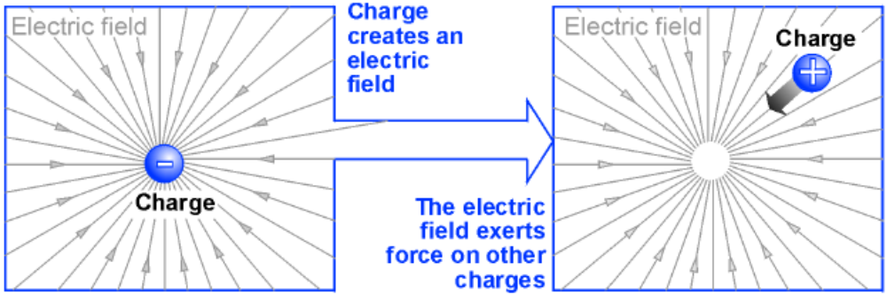
Fields and forces
The concept of a field is used to describe any quantity that has a value for all points in space.
You can think of the field as the way forces are transmitted between objects.
Charge creates an electric field that creates forces on other charges.

Slide 5
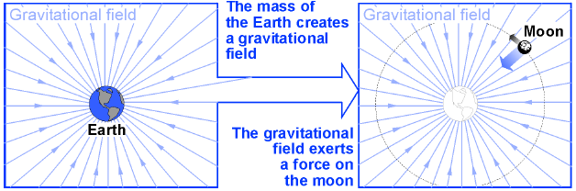
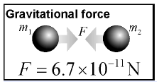
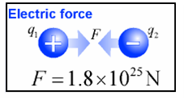
Mass creates a gravitational field that exerts forces on other masses.
Gravitational forces are far weaker than electric forces

Slide 6

The Concept of a Field
A field is defined as a property of space in which a material object experiences a force.
Above earth, we say there is a gravitational field at P.
m
.
P
F
Because a mass m experiences a downward force at that point.
No force, no field; No field, no force!
The direction of the field is determined by the force.

Slide 7
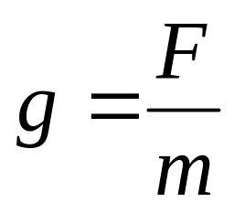
The Gravitational Field
Consider points A and B above the surface of the earth—just points in space.
•
B
Note that the force F is real, but the field is just a convenient way of describing space.
A
F
•
F
The field at points A or B might be found from:
If g is known at every point above the earth then the force F on a given mass can be found.
The magnitude and direction of the field g is depends on the weight, which is the force F.

Slide 8
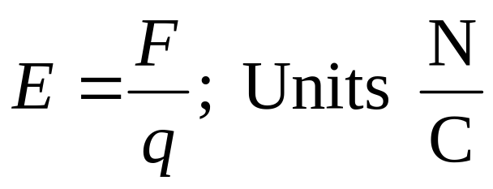
The Electric Field
1. Now, consider point P a distance r from +Q.
+q
F
.
P
+
E
2. An electric field E exists at P if a test charge +q has a force F at that point.
r
+
+
+
+
Q
+
+
+
+
3. The direction of the E is the same as the direction of a force on + (pos) charge.
Electric Field
4. The magnitude of E is given by the formula:

Slide 9
Field is Property of Space
Force on +q is with field direction.
F
.
E
-q
.
E
+q
+
-
r
Force on -q is against field direction.
r
F
+
+
+
+
+
+
+
+
Q
Q
+
+
+
+
+
+
+
+
Electric Field
Electric Field
The field E at a point exists whether there is a charge at that point or not. The direction of the field is away from the +Q charge.

Slide 10
Field Near a Negative Charge
Force on +q is with field direction.
F
.
E
-q
.
E
+q
+
-
F
r
r
Force on -q is against field direction.
-
-
-
-
-
-
-
-
-
-
-Q
-
-
-
-Q
-
-
-
Electric Field
Electric Field
Note that the field E in the vicinity of a negative charge –Q is toward the charge—the direction that a +q test charge would move.

Slide 11
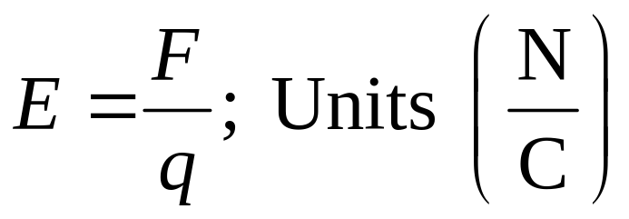
The Magnitude of E-Field
The magnitude of the electric field intensity at a point in space is defined as the force per unit charge (N/C) that would be experienced by any test charge placed at that point.
Electric Field Intensity E
The direction of E at a point is the same as the direction that a positive charge would move IF placed at that point.

Slide 12
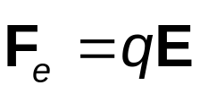
Relationship Between F and E
If q is placed in electric field , then we have
  This is valid for a point charge only
  For larger objects, the field may vary over the size of the object
If q is positive, the force and the field are in the same direction
If q is negative, the force and the field are in opposite directions

Slide 13
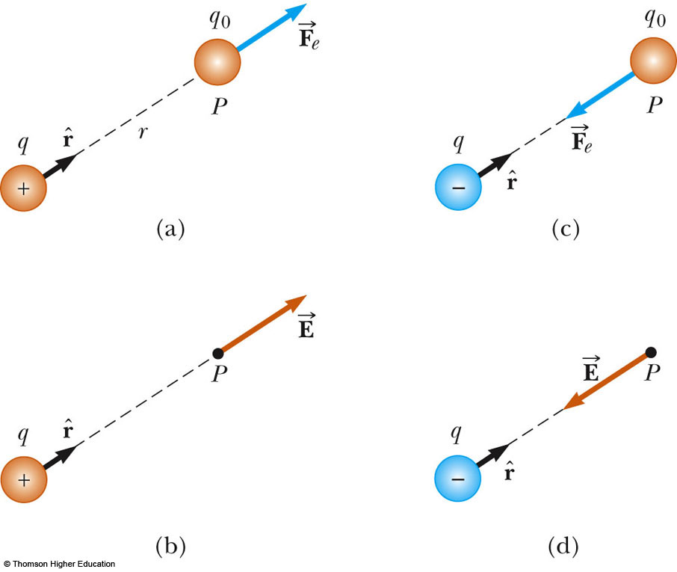
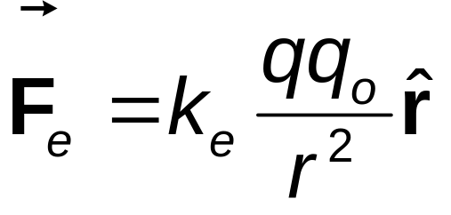
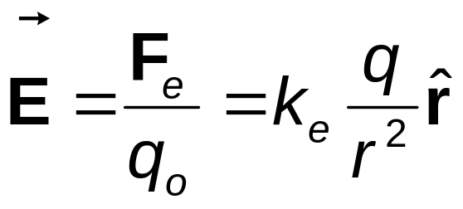
Electric Field, Vector Form
From Coulomb’s law, force between the source and test charges, can be expressed as
Then, the electric field will be

Slide 14
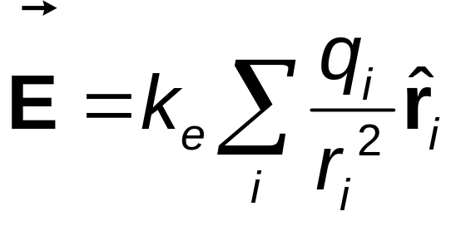
Superposition with Electric Fields
At any point P, the total electric field due to a group of source charges equals the vector sum of the electric fields of all the charges

Slide 15


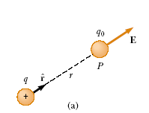

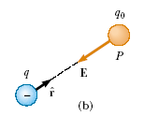

To determine the direction of an electric field, consider a point charge q located a distance r from a test charge q0 located at a point P, According to Coulomb’s law, the force exerted by q on the test charge is
The electric field created by q is

Slide 16
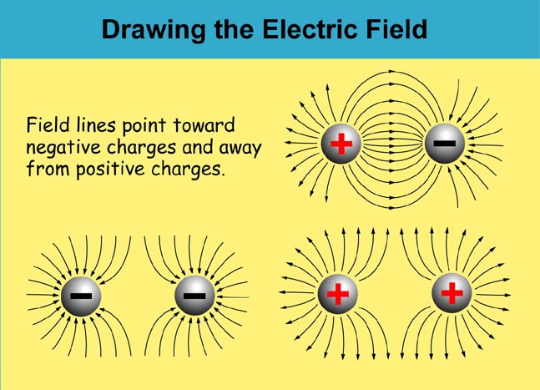

Slide 17
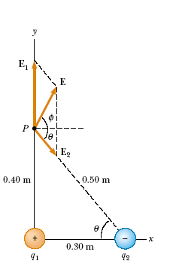
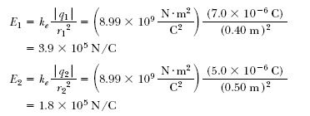



Slide 18
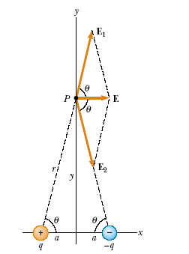


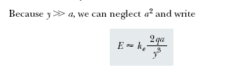

Slide 19
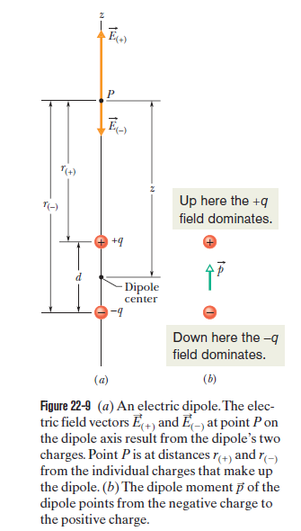
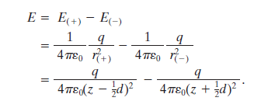
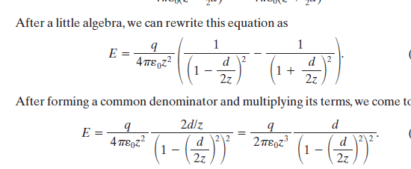
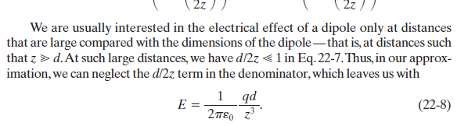

Slide 20
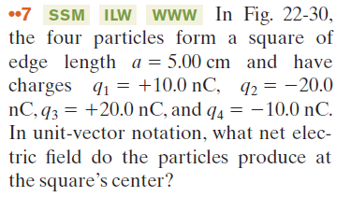
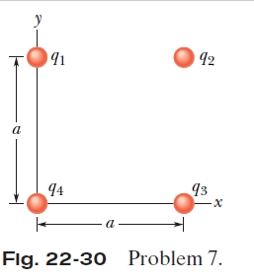

Slide 21
